Slide 1

Building a Spam Detection System with Fine-Tuned BERT
Presented By: Sabbir Mahmud Afridi

Slide 2
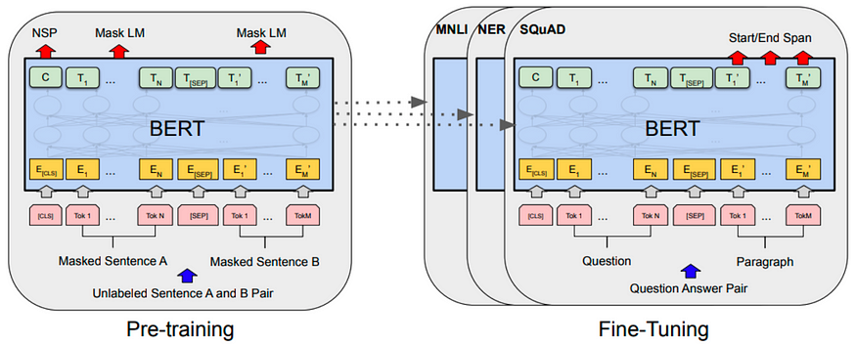
What is BERT?
BERT stands for Bidirectional Encoder Representations from Transformers.
Developed By: Researchers at Google AI, specifically Jacob Devlin and his team.
Published In: October 2018 in the paper titled "BERT: Pre-training of Deep Bidirectional Transformers for Language

Slide 3
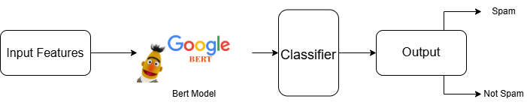
What does it mean to fine tune BERT?
Input Features:
Provide raw input data (e.g., text sequences for NLP tasks).
Pre-trained BERT Model:
Pass the input features through the pre-trained BERT model.
BERT processes the input and generates contextual embeddings for the input text.
Task-Specific Classifier:
Add a task-specific classifier (e.g., a linear layer for classification tasks).
This classifier takes the [CLS] token's embedding from BERT as input and generates predictions.
Output:
Obtain predictions tailored to the specific task (e.g., binary classification: Spam or Not Spam).

Slide 4
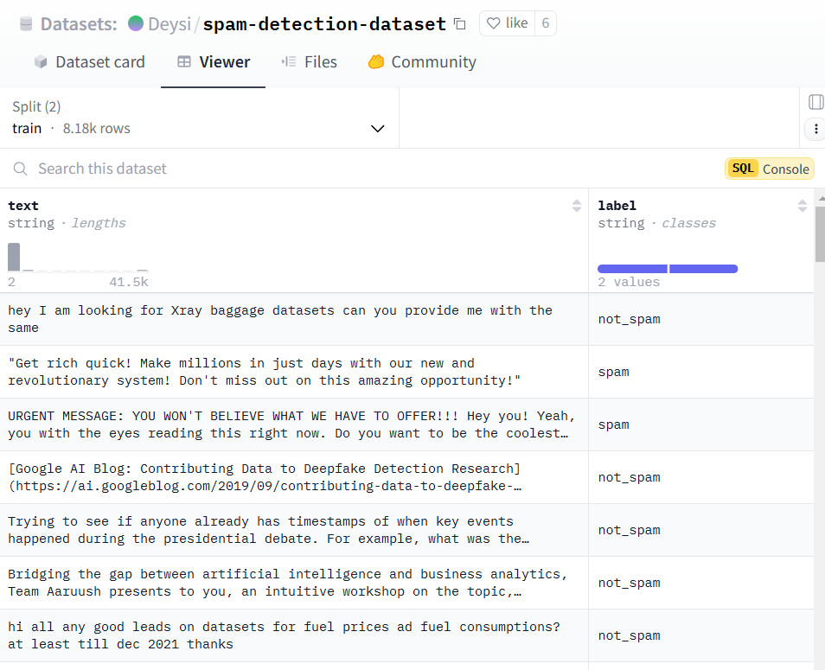
Dataset
The Deysi/spam-detection-dataset
Has two main features:
text (the message content)
label (whether the message is "spam" or "not spam").
The dataset is split into training and testing subsets:
Training set: 8,175 examples
Test set: 2,725 examples.

Slide 5
Fine-tuning BERT for detecting spam in text messages.

Slide 6
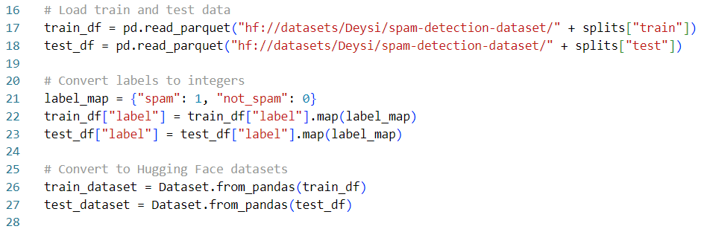
Dataset Loading and Preprocessing
Load the training and test datasets.
Map labels to integers (spam = 1, not_spam = 0).
Convert pandas DataFrames to Hugging Face Dataset format for efficient handling.

Slide 7
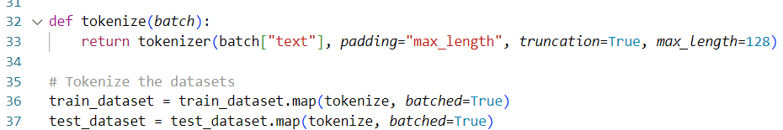
Tokenization
BERT tokenizer converts text into token IDs and attention masks.
Padding and truncation ensure fixed-length input sequences.

Slide 8
Load Pre-Trained Model
Use BertForSequenceClassification for text classification with 2 labels (spam, not_spam).
Load pre-trained BERT weights.

Slide 9
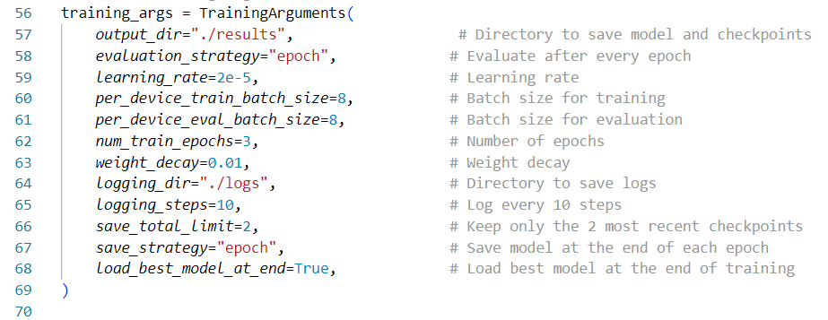
Training Configuration
Define training settings: learning rate, batch size, epochs, and evaluation frequency.
Ensure saving and loading the best model.

Slide 10
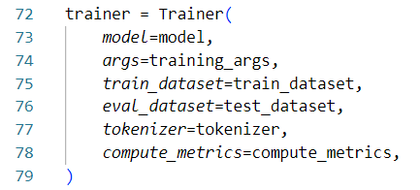
Model Training
Use Hugging Face’s Trainer API to train the model with the defined settings.

Slide 11

Saving the Model and Tokenizer
Save the trained model and tokenizer to disk for future use.

Slide 12
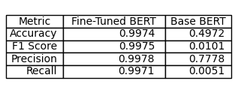
Evaluation

Slide 13
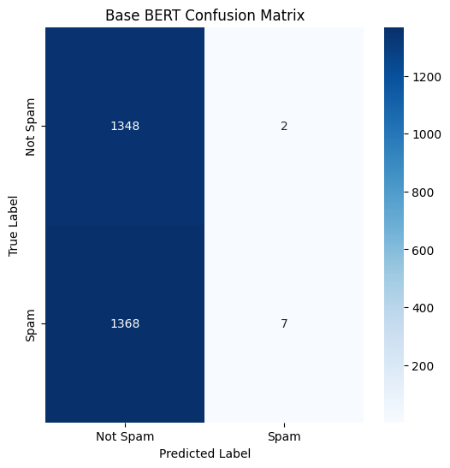
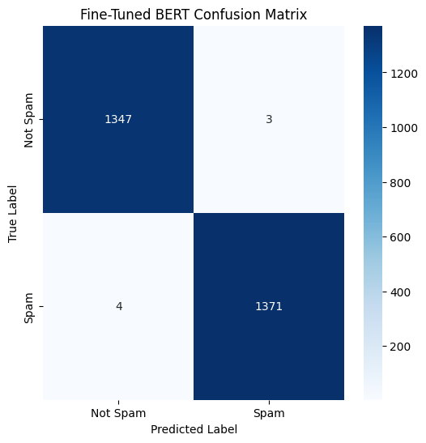
Evaluation

Slide 14
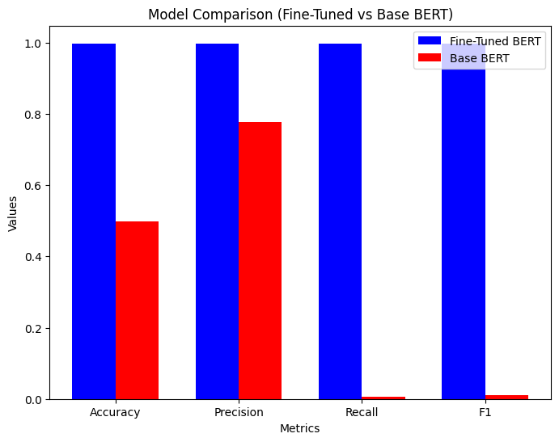
Evaluation

Slide 15
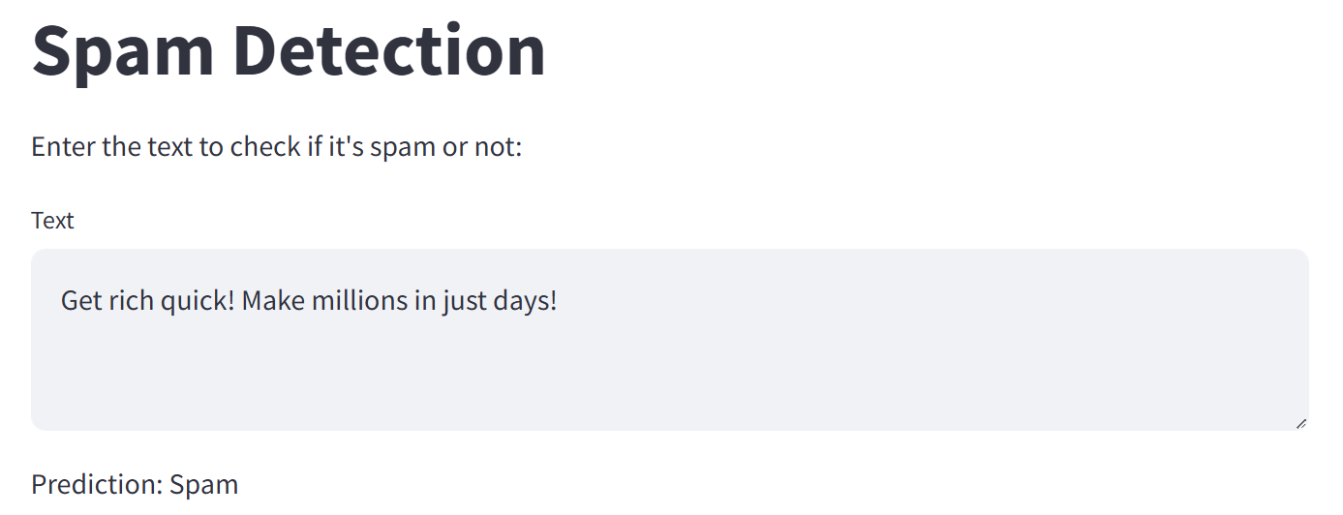
Web Application

Slide 16
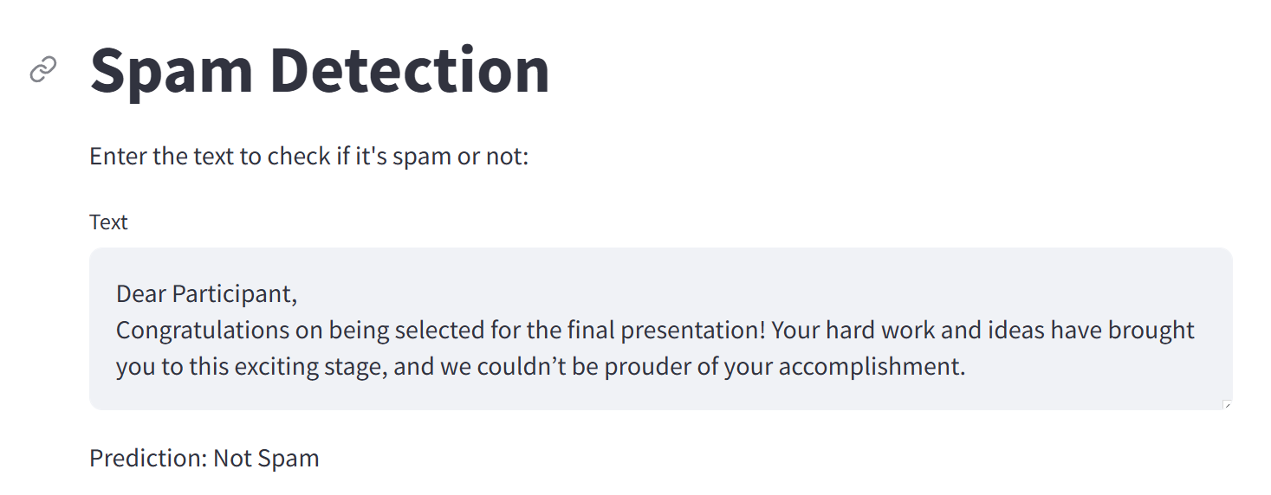
Web Application

Slide 17
Thank You

